Slide 1
Telangana Growth Analysis
- Presented by
Satheesh kumar T
01
Introduction
To get an idea about the Telangana as a State
02
Dashboard Overview
To know more insights at a single place
03
Decoding the Departments
Stamp Registration, Transportation and Ts-I pass
04
Recommendations
Providing actionable recommendations from my observation

Slide 2
INTRODUCTION

Slide 3

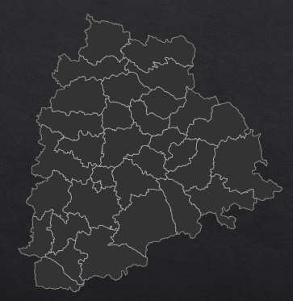
TELANGANA
Telangana was created as India’s 29th state on 2nd June 2014.
K. Chandrashekar Rao well known as KCR is the Chief Minister of Telangana,
The state had 10 districts when it was formed in 2014 and after further categorization now we have 33 districts.
At Rs 3,08,732 in 2022-23, Telangana leads the list of Indian states with the highest per capita income.
The state’s start-up-friendly ecosystem has produced 4,500+ startups.

Slide 4
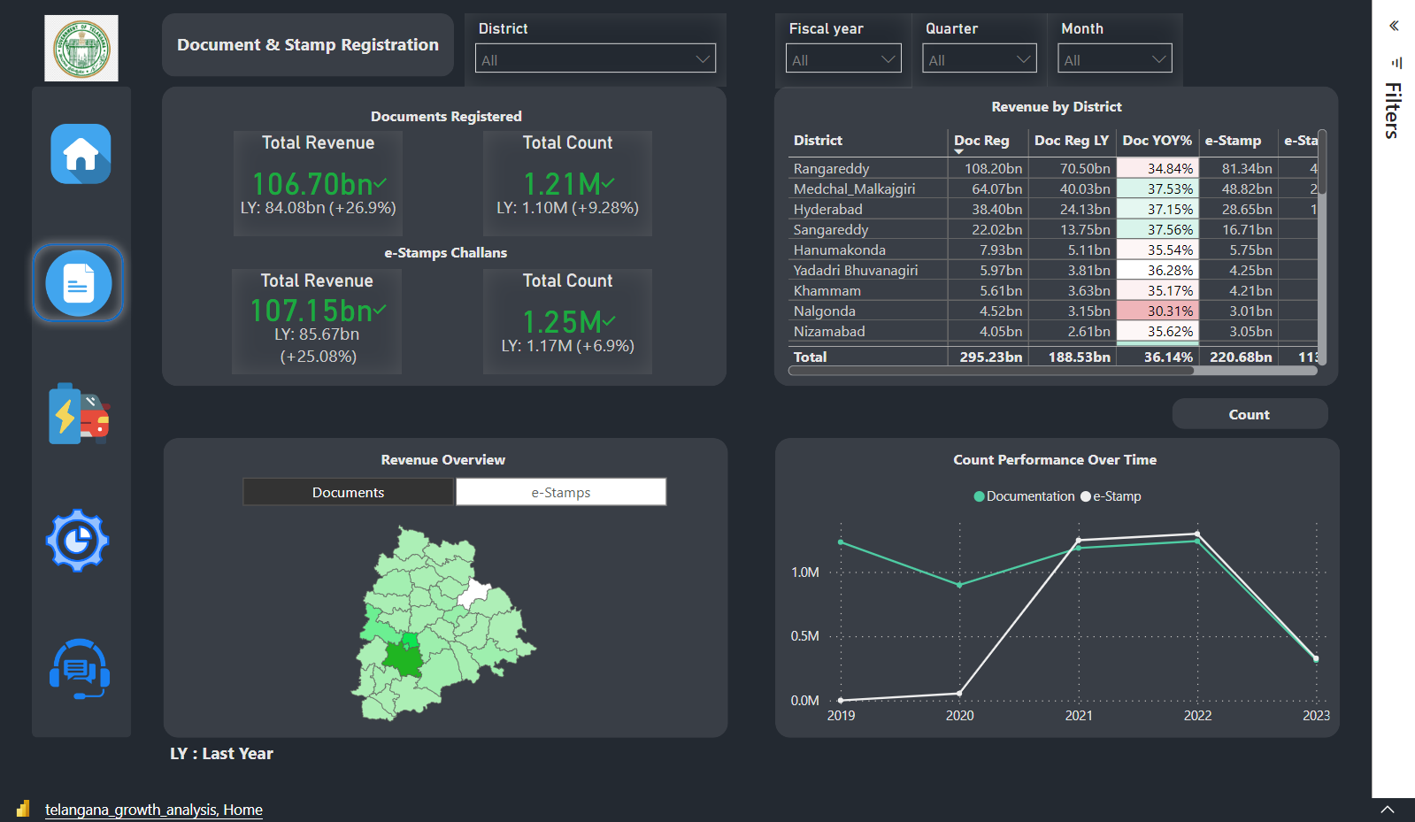
DASHBOARD OVERVIEW
Live Dashboard

Slide 5
TELANGANA GROWTH ANALYSIS
(FY 2019 – FY 2022)
DOCUMENT &
E-STAMP REGISTRATION
TRANSPORTATION
TS - IPASS

Slide 6


DOCUMENT REGISTRATION
AND
E-STAMP REGISTRATION

Slide 7
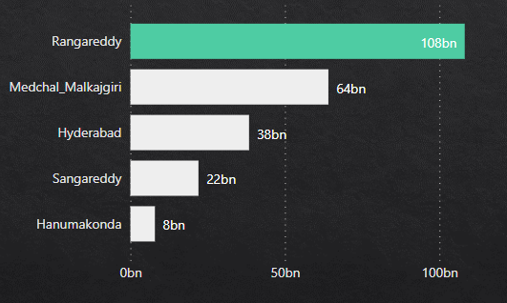
Documentation Revenue Analysis
List down the top 5 districts that showed the highest document registration revenue growth
between FY 2019 and 2022.
Rangareddy contributes 37.39% to the state’s total documentation revenue,
followed by Medchal Malkajgiri (21.23%), Hyderabad (12.80%),
Sangareddy (7.29%) and Hanumakonda (2.71%)

Slide 8
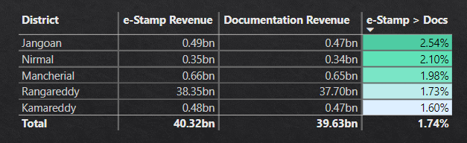
E-Stamp Revenue Analysis
List down the top 5 districts where e-stamp revenue contributes significantly more
to the revenue than the documents in FY 2022.
FY 2022
Total Revenue from 33 districts in FY 2022 is 213.85 bn
E-Stamp Revenue(107.15 bn) + Documentation Revenue (106.70 bn)
The e-Stamp revenue of the Jangoan, Nirmal, Mancherial,
Rangareddy and Kamareddy districts contribute more than their documentation revenue,
to the state’s total revenue in FY 2022.

Slide 9




How government generate revenue through document registration/ e-stamp?
During a property transaction
Birth/Death and Marriage Certificates

Slide 10
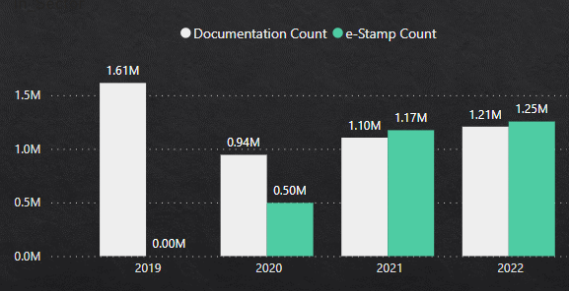
Documentation vs E-Stamp
Is there been any alteration of the e-Stamp challan count and document registration count pattern
since the implementation of the e-Stamp challan?
E-Stamp count has seen a sudden rise due to significant sectoral investments from FY 2020.
Population increases in the districts with, more educational institutions and industrial opportunities.
It increases the need for e-stamp registration.

Slide 11
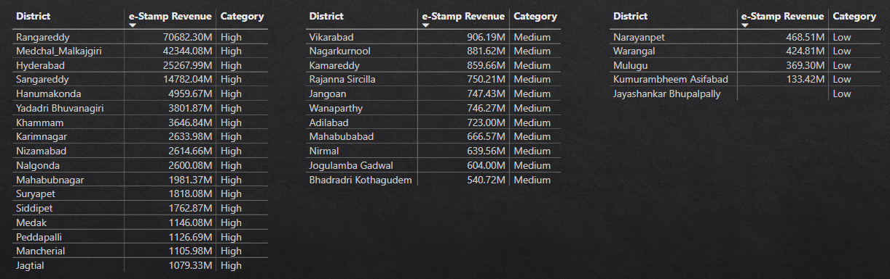
District Categorization
Categorize districts into three segments based on their stamp registration revenue generation
during the fiscal year 2021 to 2022.
The districts with e-Stamp revenue 4 times the average of all the district’s revenue, are categorized as the “High revenue” district.
The districts with e-Stamp revenue 2 times the average of all the district’s revenue, are categorized as the “Medium revenue” district.

Slide 12



Transportation
Analysis

Slide 13
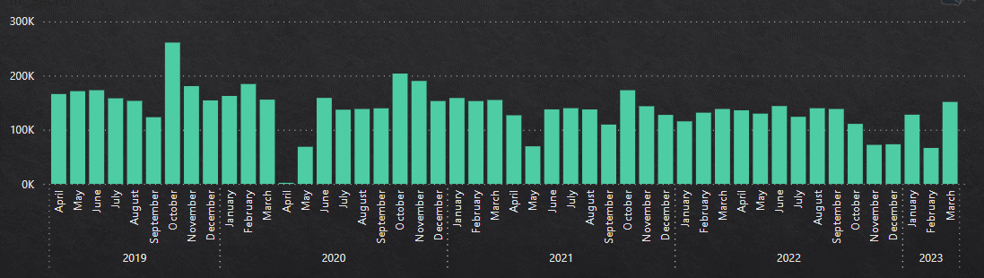
Vehicle Sales Trend
Investigate whether there is any correlation between vehicle sales and
specific months or seasons in different districts.
In every year, the October month sees the highest vehicle sales due to year-end sales and festival offers.
In April 2020 and May 2021 vehicle sales dropped significantly due to covid lockdown.

Slide 14
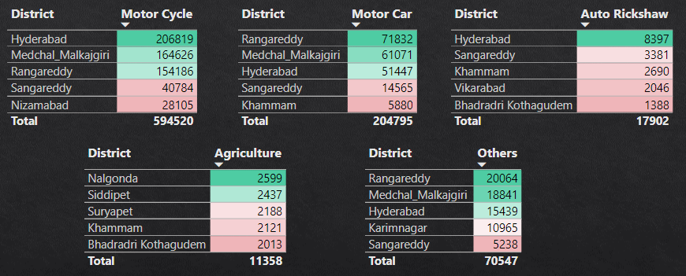
Vehicle Class Preference
How does the distribution of vehicles vary by vehicle class across different districts?
Are there any districts with a predominant preference for a specific vehicle class?
FY 2022
Quick commute vehicles like Bike, Car and Auto Rickshaw are mostly preferred by
developing districts with higher population.
Agricultural vehicles are preferred by districts with the larger farming lands.

Slide 15
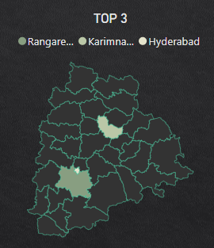
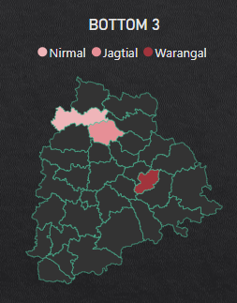
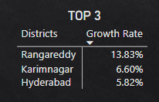
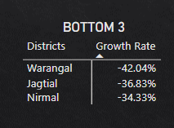
Fuel Type Preference
List down the top 3 and bottom 3 districts that have shown the highest and lowest vehicle sales growth
during FY 2022 compared to FY 2021.

Slide 16
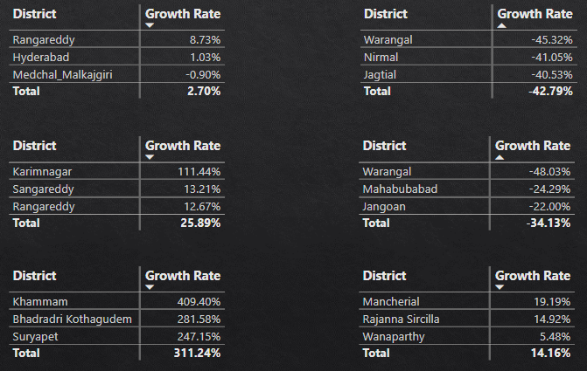
Fuel Type Preference
List down the top 3 and bottom 3 districts that have shown the highest and lowest vehicle sales growth
during FY 2022 compared to FY 2021.
TOP 3 Districts
BOTTOM 3 Districts
Petrol
Diesel
Electric

Slide 17



Telangana State Industrial Project Approval and Self-Certification System

Slide 18
BENEFITS OF TS-IPASS
All departments connected for establishing and operation of an Enterprise brought under the purview of TS-iPASS.
Time Limits set for each approval varying from 1 day to a maximum of 30 days depending upon the complexity of the approval.
Pre-scrutiny of the applications at the State Level and District Level to assist the entrepreneurs in the proper submission of applications and to avoid delay in processing the files by the departments.
Making mandatory for the Competent Authorities to seek shortfall/additional information required, if any, only once, within three days from receipt of the application.
Empowering the Entrepreneurs with the Right to clearances under TS-iPASS, to know the reasons for delay if any in getting the clearance within time limits and penalizing the officers responsible for the delay.
To know more benefits

Slide 19
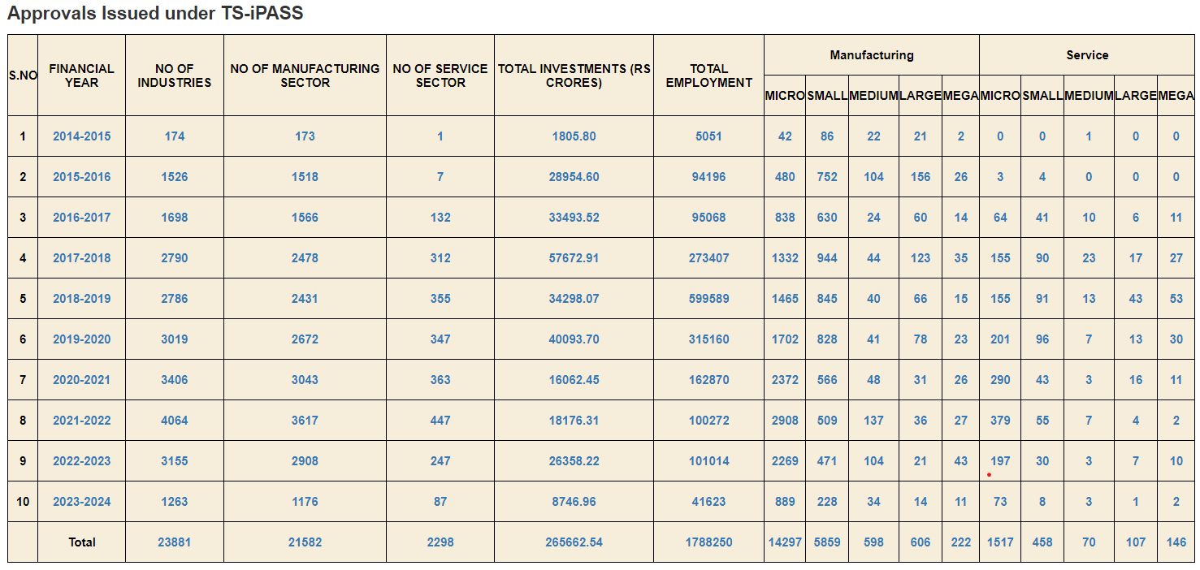
PROOF OF WORK
www.ipass.telangana.gov.in

Slide 20
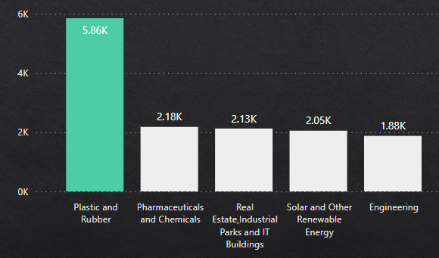
Sectoral Investment
List down the top 5 sectors that have witnessed the most significant investments in FY 2022.
FY 2022
Plastic and Rubber sector has attracted the highest investment of 22.73%(5,855 Cr),
when compared to the total sectoral investment done in FY 2022.
Compared to FY 2021, Rangareddy has seen a YOY growth of 78.69% in Plastic and Rubber sector investment in FY 2022.

Slide 21
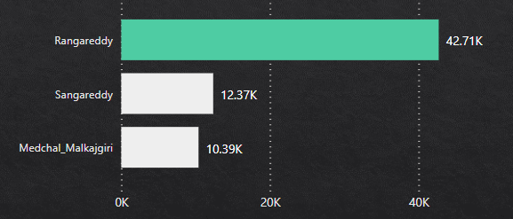
Sectoral Investment
List down the top 3 districts that have attracted the most significant sector investments
during FY 2019 to 2022.
Rangareddy has received more Real estate and IT parks investments than other districts, which helps the young minds who seek technological opportunities
Sangareddy and Medchal Malkajgiri have more Pharmaceuticals and Chemicals sector investments
Rangareddy has received more Real estate and IT parks investments than other districts, which helps the young minds who seek technological opportunities
Sangareddy and Medchal Malkajgiri have more Pharmaceuticals and Chemicals sector investments

Slide 22
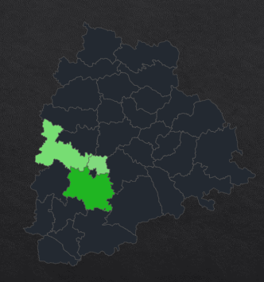
Sectoral Investment
List down the top 3 districts that have attracted the most significant sector investments
during FY 2019 to 2022.
Connectivity across the state
Skilled Labor workforce
Potential Infrastructure for increasing population
Supporting MSMEs

Slide 23
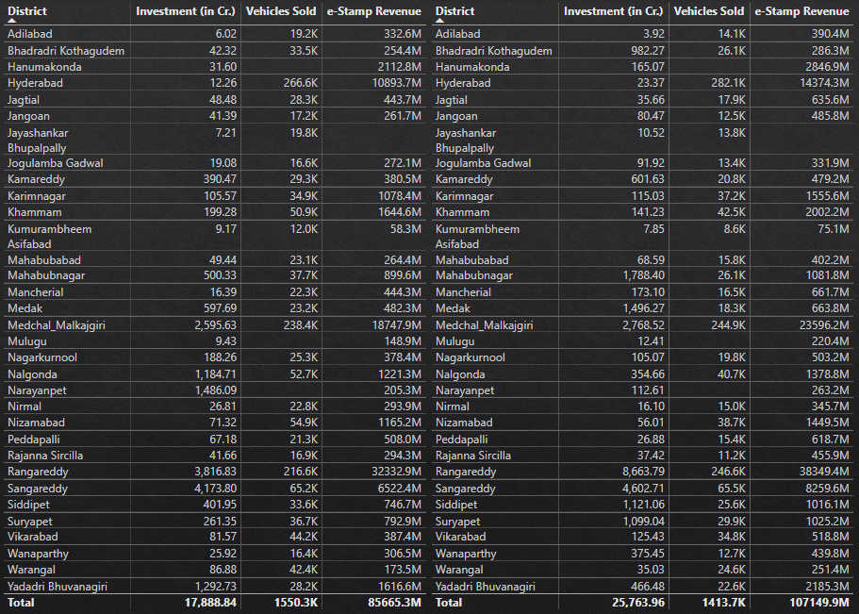
Sectoral Investment
Is there any relationship between district investments, vehicle sales and stamps revenue within the same district between FY 2021 and 2022?
FY 2021
FY 2022
We have a positive correlation between the Investment done in a district with respect to vehicles sold and e-stamp revenue

Slide 24
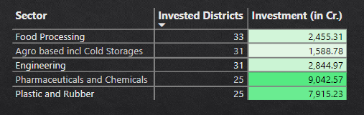
Sectoral Investment
Are there any particular sectors that have shown substantial investment in multiple districts
between FY 2021 and 2022?
Pharmaceuticals and Chemical sector have contributed the highest investment of 20.71%,
to the total sectoral investment done between FY 2021 and 2022.
The Food Processing sector has invested in all the districts of Telangana, followed by
Agro-based and cold storage (31) and Engineering (31).

Slide 25
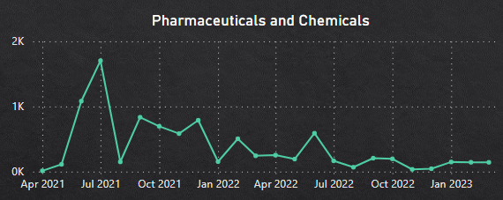
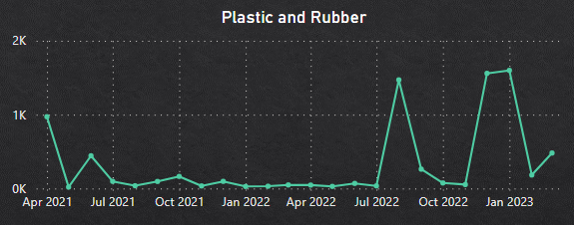
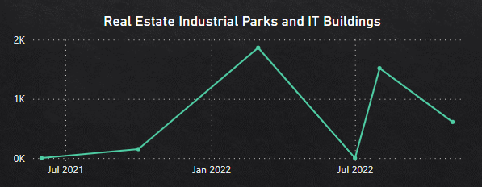
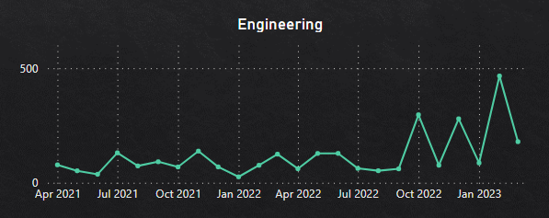
Sectoral Investment
Do certain sectors experience higher investments during particular months?

Slide 26
RECOMMENDATIONS

Slide 27
Top 5 Districts to buy a commercial property in Telangana
Hyderabad
Rangareddy
Medchal Malkajgiri
Sangareddy
Yadadri Bhuvanagiri

Slide 28
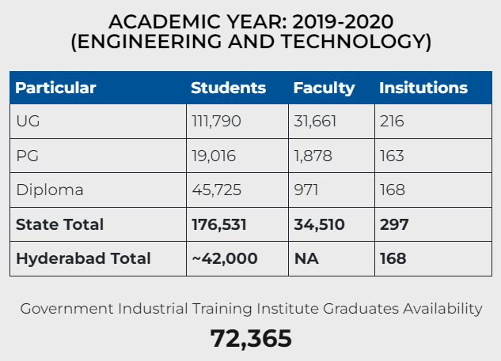
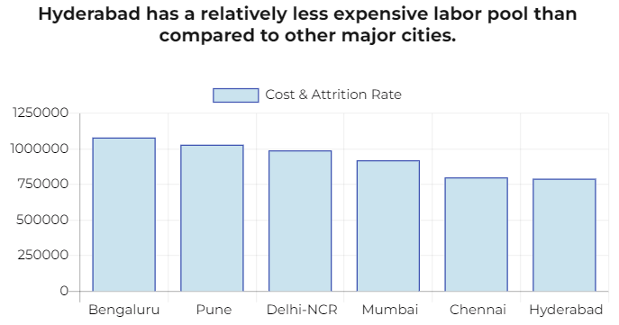
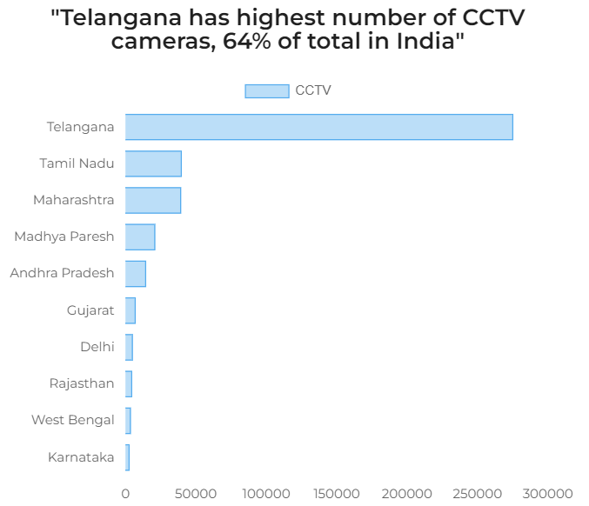
Reasons for choosing a district to buy a commercial property
Educational Institutions
Nominal Labor Cost
Safety
To know more
To know more
To know more

Slide 29
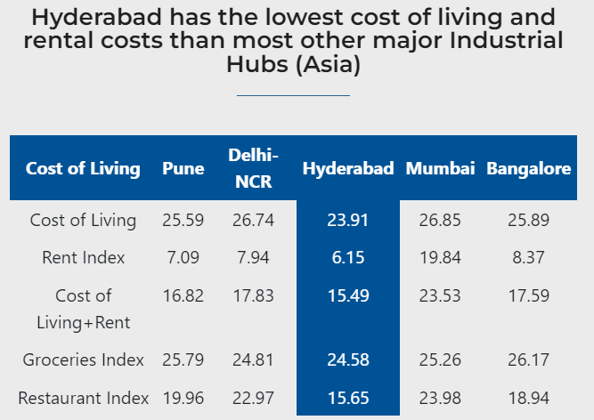

Reasons for choosing a district to buy a commercial property
Connectivity
Cost of living
To know more
To know more

Slide 30






What significant policies or initiatives were put into effect to enhance economic growth, investments,
and employment in Telangana by the current government?
T-HUB
TSIC
WE-HUB
T-WORKS
RICH
TASK

Slide 31




AREAS MISSED TO FOCUS
PROMOTING E-STAMPS
Benefits of e-stamp registration
Reduction of manual process and documentation.
No registration window time, it allows citizens to complete the process on their own phase.
Defacing challans in e-STAMPS, prevents fake challans and reuse of challans.
Payments can be made accurately and acceptability of multiple challans for a single document.
Verification made easy for citizens and SRO.

Slide 32
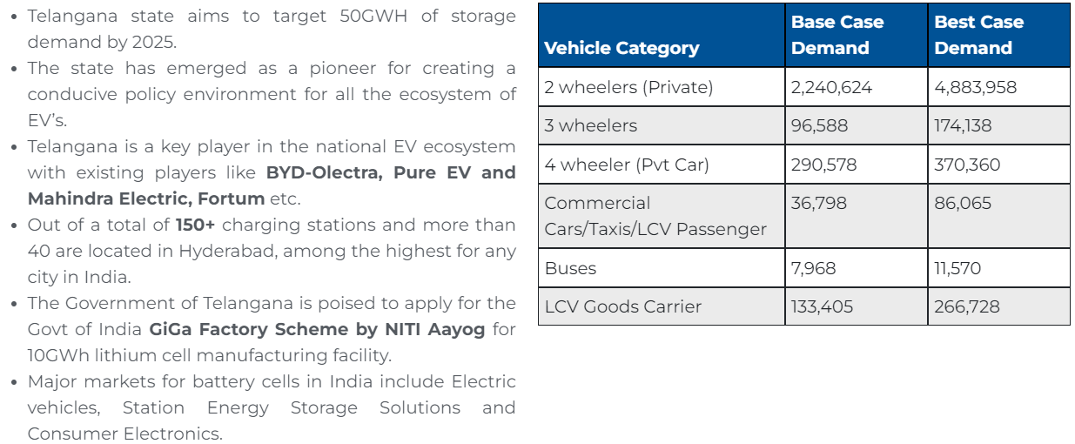
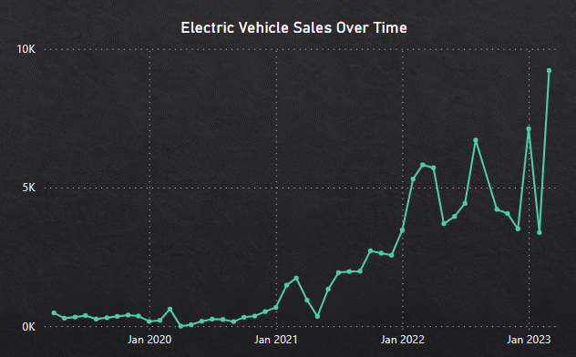
AREAS MISSED TO FOCUS
ELECTRIC VEHICLES
EV
Investing more in eco-friendly EV industries will create more job opportunities.

Slide 33
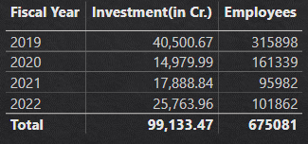
AREAS MISSED TO FOCUS
EMPLOYMENT RATIO
Even though with an increase in the investment compared to each FY, the employment rate is very low.
Investing more in automating the process will lead to more unemployment, to tackle this government can start learning hub initiatives to skill up the employees.

Slide 34
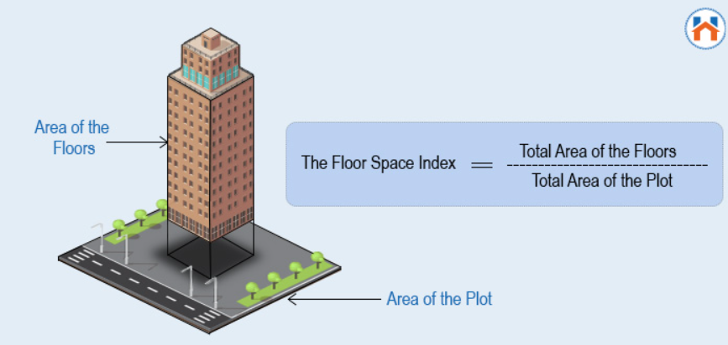
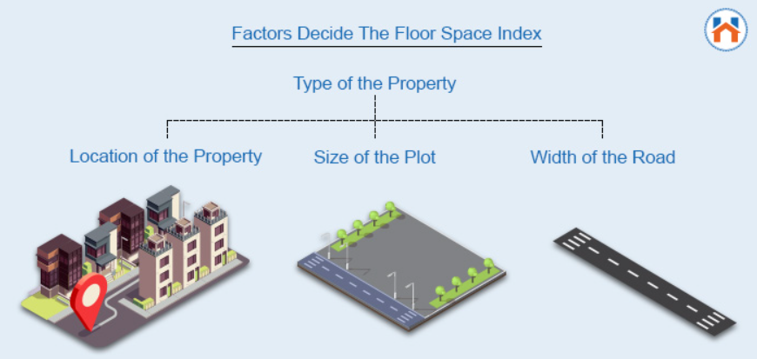
AREAS MISSED TO FOCUS
FLOOR SPACE INDEX
A higher FSI means more construction is allowed on the land, which can increase the property’s value.
FLOOR SPACE INDEX
FLOOR SPACE INDEX

Slide 35
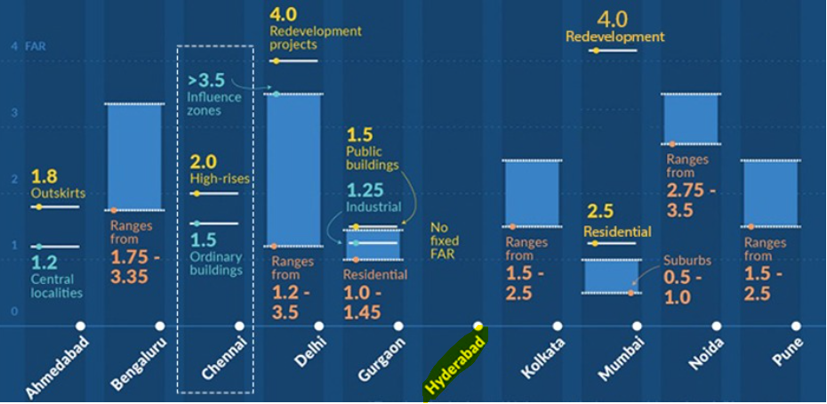
Hyderabad’s Floor Space Index
FLOOR SPACE INDEX
Hyderabad follows an unlimited FSI where developers can construct as per their choice.
In India, Hyderabad is the only city with FSI anywhere between 9 and 13, with an average hovering from 6 to 7, whereas the national average ranges between 2 to 2.5.

Slide 36
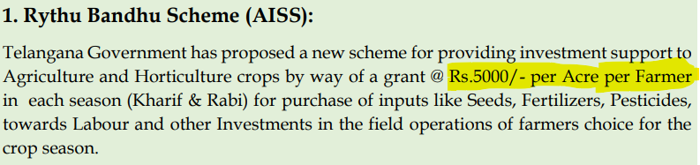
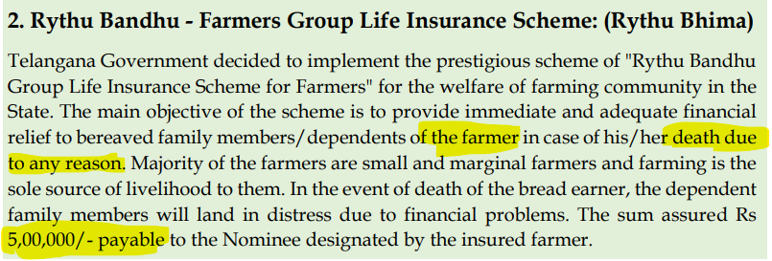
SUPPORTING FARMERS
CGSchemes

Slide 37


CODEBASICS
Founder
Co-Founder
Dhaval Patel
Hemanand Vadivel

Slide 38
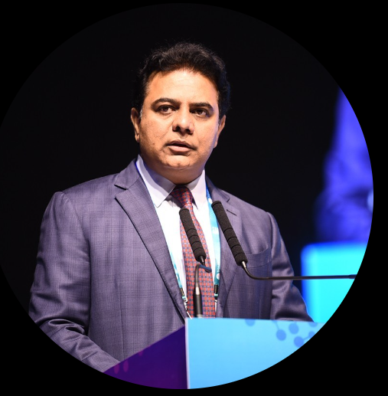



GOVERNMENT OFFICIALS OF TELANGANA
KTR
JAYESH RANJAN
DILEEP KONATHAM
VENU PANJARLA
Minister for IT, Industries and Municipal Administration
Secretary, Information Technology (IT), Government of Telangana:
Director at Government of Telangana
Open Data Consultant to the Government of Telangana

Slide 39
Thank You!

